Slide 1
October 2025
Model Predictive Path Integral Control for Roll-to-Roll Manufacturing
Presentation for the Modeling, Estimation, and Control Conference (MECC) 2025
Christopher Martin*, Apurva Patil, Takashi Tanaka, Wei Li, Dongmei Chen
*PhD candidate, The University of Texas at Austin

Slide 2
Outline
Motivation: Roll-to-roll (R2R) manufacturing
Background: Model predictive path integral (MPPI) control
Proposed Method : MPPI control for R2R systems
Results: Case Study Comparison
Conclusions: Contributions and future work
Notes:
-Just say: Here is the outline

Slide 3

Motivation: R2R Manufacturing

Slide 4
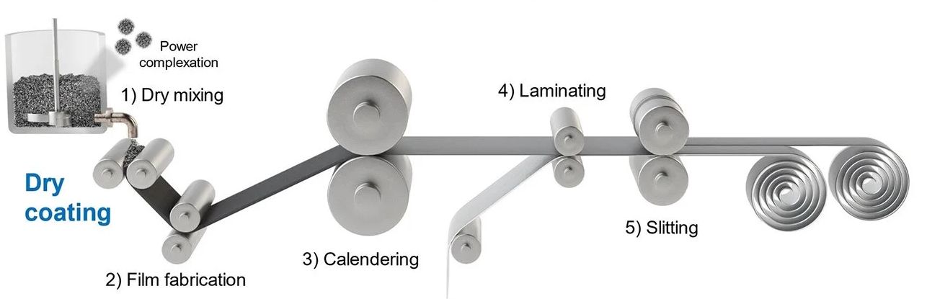
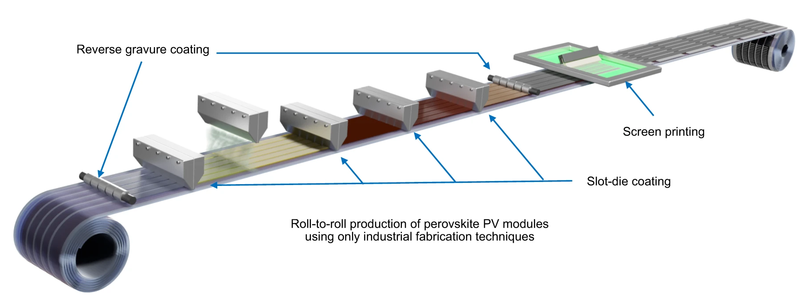
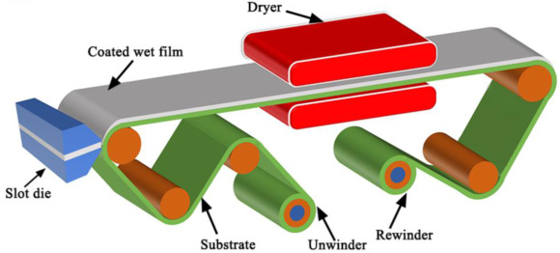
Roll-to-Roll (R2R) Manufacturing
Benefits: Continuous and high-throughput.
Advanced Applications: Lithium-ion batteries, PEM fuel cells, flexible solar cells.
Figure 1: An R2R process for LIBs
Figure 2: An R2R process for flexible solar cells
Figure 3: An R2R process for PEM fuel cells
Notes:
-Define R2R manufacturing
-Give benefits
-Give advanced applications

Slide 5
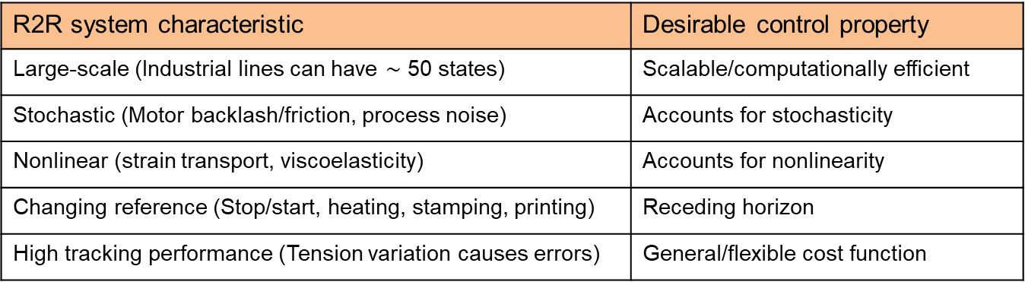
Roll-to-Roll (R2R) Manufacturing: Challenges
R2R system characteristic | Desirable control property
Large-scale (Industrial lines can have $\sim$ 50 states) | Scalable/computationally efficient
Stochastic (Motor backlash/friction, process noise) | Accounts for stochasticity
Nonlinear (strain transport, viscoelasticity) | Accounts for nonlinearity
Changing reference (Stop/start, heating, stamping, printing) | Receding horizon
High tracking performance (Tension variation causes errors) | General/flexible cost function
Is there a control method that meets all these requirements?
Proposed Solution: Model predictive path integral (MPPI) control
Notes:
-Points to emphasize
Large-scale
Nonlinear modeling information and disturbance information
We need high tension performance for advanced applications. Specifically register error in high-precision printing.
-Ask question
-Our assertion is that MPPI is a good candidate to control this system, meeting these requirements.

Slide 6
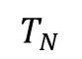
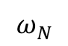
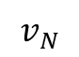
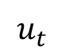
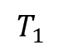
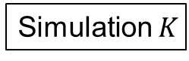
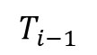
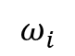
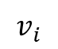
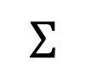
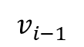
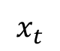
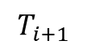
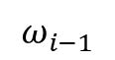
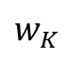
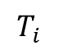
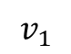
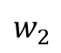
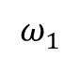
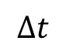
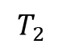
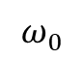
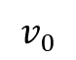
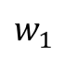
Proposed Method Overview
R2R Plant
Key Benefits:
Computational burden scales linearly.
Nonlinearity and stochasticity are naturally included.
Cost function is general with respect to the state.
Encoder
Loadcell
$$v_{0}$$
$$v_{1}$$
$$v_{i−1}$$
$$v_{i}$$
$$v_{N}$$
$$T_{1}$$
$$T_{2}$$
$$T_{i−1}$$
$$T_{i}$$
$$T_{i+1}$$
$$T_{N}$$
$$ω_{1}$$
$$ω_{i−1}$$
$$ω_{i}$$
$$ω_{0}$$
$$ω_{N}$$
$$Δt$$
MPPI Controller
$$w_{1}$$
Simulation 1
$$x_{t}$$
ZOH
$$u_{t}$$
$$Σ$$
$$w_{2}$$
Simulation 2
GPU
…
…
…
…
$$w_{K}$$
Simulation $K$
Notes:
-Can measure the state using encoders and loadcells
-Feed measured state into the MPPI controller
-Explain connection between path integral control and MPPI
-The key idea of path integral control is that, given certain conditions, we can calculate the optimal control signal with a purely Monte-carlo approach. We do not need to solve any QPs to get the optimal control solution over the prediction horizon.
-This approach is enabled by GPUs
-MPPI is path integral control in a receding horizon framework.
-Go through each of the key benefits

Slide 7
Background: Model Predictive Path Integral Control

Slide 8
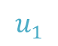
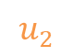
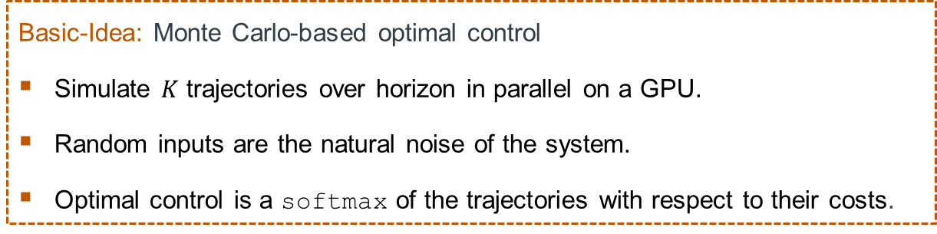
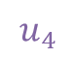
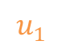
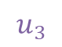
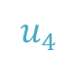
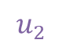
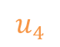
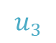
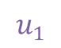
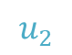
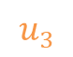
Path Integral Control: Fixed-Horizon Control
Basic-Idea: Monte Carlo-based optimal control
Simulate $K$ trajectories over horizon in parallel on a GPU.
Random inputs are the natural noise of the system.
Optimal control is a softmax of the trajectories with respect to their costs.
Costs
800
100
2000
$$u_{4}$$
$$u_{4}$$
Benefits: General, optimal, and scalable.
Cost function can be completely general w.r.t. the state.
No approximation of the full nonlinear dynamics is necessary to find the optimal solution. No gradients.
Stochasticity is naturally included in the optimal solution.
Simulation rollouts are parallelizable on modern GPUs.
Computation scales linearly with prediction horizon.
$$u_{3}$$
$$u_{3}$$
$$u_{2}$$
$$u_{2}$$
$$u_{4}$$
$$u_{1}$$
$$u_{1}$$
$$u_{1}$$
$$u_{3}$$
$$u_{2}$$
Figure 5: Path integral control
Notes:
-Transition into Path Integral control. Fixed-horizon
-Go through each of the basic ideas
-Bring up the benefits, hit the top three points
-Mention that path integral control is often applied in the autonomous driving setting. Go over example.

Slide 9
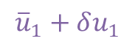
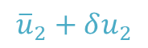
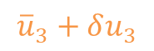

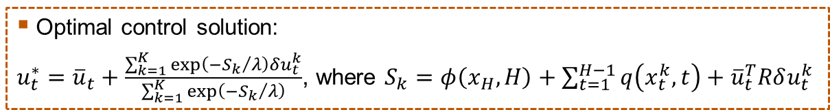
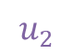
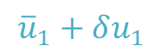
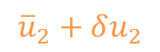
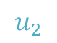
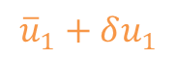


















Path Integral Control with Importance Sampling
System Structure:
$x_{t+1}=x_{t}+\left(f\left(x_{t},t\right)+Gu_{t}+B\frac{ε_{t}}{\sqrt{∆t}}\right)Δt$, where $ε_{t}\sim 𝒩(0,Σ)$,
$f\left(x_{t},t\right)=\left(\begin{matrix}f_{a}\left(x_{t},t\right) \\ f_{c}\left(x_{t},t\right)\end{matrix}\right)$, $x_{t}=\left(\begin{matrix}x_{t}^{a} \\ x_{t}^{c}\end{matrix}\right)$, $G=\left(\begin{matrix}0 \\ G_{c}\end{matrix}\right)$, $B=\left(\begin{matrix}0 \\ B_{c}\end{matrix}\right)$
$${\overline{u}}_{4}$$
$$+δu_{4}$$
$${\overline{u}}_{4}+δu_{4}$$
$${\overline{u}}_{4}$$
$$+δu_{4}$$
Costs
800
100
2000
Costs
300
100
200
$$u_{4}$$
$$u_{4}$$
$${\overline{u}}_{3}$$
$$+δu_{3}$$
$${\overline{u}}_{3}+δu_{3}$$
Cost function structure:
$J=\min_{u}{𝔼\left[φ\left(x_{H},H\right)+\sum_{t=1}^{H−1}{q\left(x_{t},t\right)}+\frac{1}{2}u_{t}^{T}Ru_{t}\right]}$, where $R=λG_{c}^{T}B_{c}^{−T}B_{c}^{−1}G_{c}$
$${\overline{u}}_{3}+δu_{3}$$
$$u_{3}$$
$$u_{3}$$
$${\overline{u}}_{2}+δu_{2}$$
$${\overline{u}}_{2}+δu_{2}$$
$$u_{2}$$
Monte Carlo rollout dynamics:
$x_{t+1}=x_{t}+f\left(x_{t},t\right)Δt+G\left({\overline{u}}_{t}+δu_{t}\right)Δt$, where $Gδu_{t}=B\frac{ε_{t}}{\sqrt{∆t}}$
$${\overline{u}}_{1}+δu_{1}$$
$$u_{2}$$
$${\overline{u}}_{2}+δu_{2}$$
$$u_{1}$$
$$u_{4}$$
$$u_{1}$$
$${\overline{u}}_{1}+δu_{1}$$
$${\overline{u}}_{1}+δu_{1}$$
$$u_{1}$$
$$u_{3}$$
Optimal control solution:
$u_{t}^{∗}={\overline{u}}_{t}+\frac{\sum_{k=1}^{K}{\exp\left({−S_{k}}/λ\right)δu_{t}^{k}}}{\sum_{k=1}^{K}{\exp\left({−S_{k}}/λ\right)}}$, where $S_{k}=φ\left(x_{H},H\right)+\sum_{t=1}^{H−1}{q\left(x_{t}^{k},t\right)+{\overline{u}}_{t}^{T}Rδu_{t}^{k}}$
$$u_{2}$$
Figure 6: Path integral control with importance sampling
Figure 5: Path integral control
Notes:
-Seems too good to be true. There is a catch.
-First, the system has to be separable
-Second, the control cost has to have a certain structure.
-Then, go over importance sampling
-Then, go over optimal control solution

Slide 10




Model Predictive Path Integral (MPPI) Control
Start: $t=0$,
initialize $u_{i|0}$, $i$ = 1, 2, …, $H−1$
$$t←t+1$$
Measure: $x_{t}$
Generate $K$ rollouts over a prediction horizon $H$:
for $k$ = 1:$K$, $x_{i+1|t}^{k}←x_{i|t}^{k}+\left(f\left(x_{i|t}^{k},t\right)+G\left(u_{i|t}+δu_{i|t}^{k}\right)\right)Δt$, $i$ = 1, 2, …, $H−$ 1
Update control with weighted average of $K$ rollouts:
$u_{i|t}←u_{i|t}+\frac{\sum_{k=1}^{K}{\exp\left({−S_{k}}/λ\right)δu_{i|t}^{k}}}{\sum_{k=1}^{K}{\exp\left({−S_{k}}/λ\right)}}$, $i$ = 1, 2, …, $H−$ 1, where $S_{k}=φ\left(x_{H},H\right)+\sum_{t=1}^{H−1}{\tilde{q}\left(x_{t}^{k},{\overline{u}}_{t},δu_{t}^{k},t\right)}$
Input Control: $u_{1|t}→$ send to actuator
Shift control for next timestep: $u_{i|t+1}←u_{i+1|t}$
Notes:
-Emphasize that this is the receding-horizon version of path-integral control.
-Quickly go over each box.
-Make comparison against QP-based NMPC

Slide 11
Proposed Method: MPPI Control for R2R Systems

Slide 12


Formulating R2R Systems in the Path Integral Paradigm
Control and disturbance on same channel.
Stochastic dynamic equations:
$$T_{i}\left(t+1\right)=T_{i}(t)+\left(\frac{AE}{L_{i}}\left(v_{i}\left(t\right)−v_{i−1}\left(t\right)\right)+\frac{1}{L_{i}}\left(T_{i−1}\left(t\right)v_{i−1}\left(t\right)−T_{i}\left(t\right)v_{i}\left(t\right)\right)\right)Δt$$
$$v_{i}\left(t+1\right)=v_{i}\left(t\right)+\left(\frac{R_{i}^{2}}{J_{i}}\left(T_{i+1}\left(t\right)−T_{i}\left(t\right)\right)−\frac{f_{i}}{J_{i}}v_{i}\left(t\right)+\frac{R_{i}}{J_{i}}u_{i}\left(t\right)+\frac{b_{i}}{\sqrt{Δt}}ε_{i}\left(t\right)\right)Δt$$
Notice that the control is affine and that the system is separable:
$f\left(x_{t},t\right)=\left(\begin{matrix}f_{a}\left(x_{t},t\right) \\ f_{c}\left(x_{t},t\right)\end{matrix}\right)$, $x_{t}=\left(\begin{matrix}x_{t}^{a} \\ x_{t}^{c}\end{matrix}\right)$, where $x_{t}^{a}={\left[T_{1}, T_{2}, …,T_{N}\right]}^{T}$ and $x_{t}^{c}={\left[v_{1}, v_{2}, …,v_{N}\right]}^{T}$.
Figure 8: R2R MPPI control problem formulation
Additionally, notice that since R2R lines are in series, the complexity of the model increases linearly with the number of web sections.
Thus, the complexity of the Monte Carlo rollouts scales linearly with the size of the system
Figure 7: Schematic of a simplified R2R line
Notes:
-So how do R2R systems fit into the path integral control framework? Very well
-Point out the velocity and tension channels. Emphasize that they are separable
-Then go over how they grow linearly because of the series nature of R2R lines.

Slide 13


R2R MPPI: Challenges Addressed
R2R system characteristic | Desirable control property
Large-scale (Industrial lines can have $\sim$ 50 states) | Scalable/computationally efficient
Stochastic (Motor backlash/friction, process noise) | Accounts for stochasticity
Nonlinear (strain transport, viscoelasticity) | Accounts for nonlinearity
Changing reference (Stop/start, heating, stamping, printing) | Receding horizon
High tracking performance (Tension variation causes errors) | General/flexible cost function
Does MPPI control satisfy this requirement?
$←$ Parallelizable, complexity grows linearly
$←$Stochasticity explicitly included in simulations
$←$Full nonlinear model used in simulations
$←$Has a receding horizon structure
$←$Cost function completely general w.r.t. state
Notes:
-So, MPPI control fits well with R2R manufacturing systems and it addresses all of the key challenges that we have identified.
-Computationally efficient
-Exact, no approximation
-High-performance

Slide 14
Results

Slide 15



Simulation Setup
Three controllers used:
Baseline linear MPC with quadratic cost function
MPPI controller with same quadratic cost function
MPPI controller with a cost function with an $L_{1}$ term
Figure 7: Schematic of a simplified R2R line
Quadratic cost function
$$q\left(x_{t},t\right)={\left\|x_{t}−x_{t}^{r}\right\|}_{Q}$$
$L_{1}$ cost function
$$q\left(x_{t},t\right)={\left\|x_{t}−x_{t}^{r}\right\|}_{Q}$$
$$+\sum_{i=1}^{N}{q_{L_{1}}\left|T_{i}\left(t\right)−T_{i}^{r}\left(t\right)\right|}$$
Purpose: Demonstrate the utility of having a general (non-differentiable) cost function.
System characteristics: 6 web sections, physical parameters meant to mimic a typical R2R line, sampling time 0.01 s.
Figure 8: R2R MPPI control problem formulation
Notes:
-Go quickly over this part.
-State that the simulation environment is meant to mimic a typical industrial R2R line.
-Just state the three controllers
-State the purpose (Activate the animation)
-Highlight the sampling time of 10 ms.

Slide 16
Tension Step Response
Web section |  | 1 | 2 | 3 | 4 | 5 | 6
Convergence time (s) | LMPC | 0.65 | 0.77 | 0.61 | 0.54 | 0.50 | 0.31
 | MPPI w/o L1 | 0.82 | 0.95 | 0.90 | 0.95 | 0.55 | 0.26
 | MPPI w/ L1 | 0.33 | 0.29 | 0.27 | 0.21 | 0 | 0
Maximum Tension Deviation (%) | LMPC | 12.7 | 14.3 | 0.41 | 11.8 | 8.04 | 2.59
 | MPPI w/o L1 | 11.4 | 13.5 | 0.80 | 11.1 | 9.38 | 3.22
 | MPPI w/ L1 | 9.18 | 11.0 | 0.18 | 6.63 | 0.75 | 0.53
Table 1: Tension step response results statistics
Figure 7: Schematic of a simplified R2R line
Figure 9: Tension control results. (left) The overall tension response, (middle) a zoom-in on the tension response, and (right) a zoom-in on the control effort.
Notes:
-So here are the results
-Just follow the animations

Slide 17






Tension Step Response Windows
Current
time
Notes:
-GO quickly
-And this is just an illustration of how the MPPI control approach works for this simulation
-You can see in each window we are simulating forward online and then taking a weighted average of the best trajectories

Slide 18
Conclusions
Many of the challenges associated with R2R control such as nonlinearity, stochasticity, and scalability are addressed by MPPI control.
A case study demonstrates that an MPPI controller with a non-differentiable cost function out-performs a linear MPC with a quadratic cost function in a simulation of a typical R2R line.
Looking forward, as advanced manufacturing lines are increasingly equipped with modern GPUs, MPPI control is a promising method for high-performance R2R manufacturing.
Notes:
-Read the bullet points
-Instead of structure fit, we formulate R2R control into mppi

Slide 19
Acknowledgments
Thanks to my collaborators, Dr. Apurva Patil, Dr. Wei Li, Dr. Takashi Tanaka, and Dr. Dongmei Chen.
Additionally, thanks to the National Science Foundation for supporting this work under Cooperative Agreement No. EEC-1160494 and CMMI-2041470.

Slide 20
THANK YOU.
Christopher Martin, PhD candidate
916-267-3386 or cbmartin129@utexas.edu

